Slide 1


Introduction to Usability/ Accessibility Concepts
IGATE is now a part of Capgemini
Notes:
Notes:
©2016 Capgemini. All rights reserved. The information contained in this document is proprietary and confidential. For Capgemini only.

Slide 2
Document History
Date | Course Version No. | Software Version No. | Developer / SME | Change Record Remarks
17-July-2017 | 0.1D |  | Rahul Vikash

Slide 3
Course Goals and Non Goals
Course Goals
What is Usability
Overview of User Centered Design
Methodology - User Experience Management
What is Usability Testing & the Tools
Web Accessibility
Checking a website for Accessibility
Web Accessibility-508

Slide 4
Pre-requisites
There are no pre-requisites for this course

Slide 5

Intended Audience
New entrants to the organization (Fresher’s batches)

Slide 6
Objective
To Understand the following :
What is Usability?
Overview of User Centered Design
Our Methodology - User Experience Mgmnt
What is Usability Testing & the Tools
Web Accessibility
Checking a website for Accessibility
Web Accessibility-508
Notes:
Tell the participants that we are just briefly touching these topics for their general awareness purpose. Some of these topics have a separate training program of their own.

Slide 7
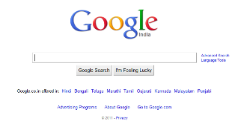
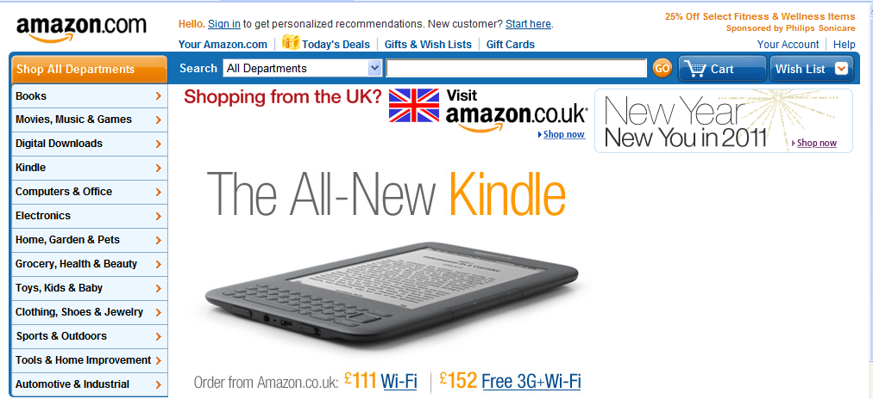
What is Usability?
Usability means making objects easier to use, and matching them more closely to user needs and their requirements.
The object of use can be a software application, website, book, tools, machine, process or anything a human interacts with.
Notes:
What is Usability?
Usability means making human handled objects easier to use, and matching them more closely to user needs and their requirements. The object of use can be a software application, website, book, tools, machine, process, or anything a human interacts with.
Additional notes for instructor

Slide 8

What is Usability?
According to ISO 13407
Usability:
The extent to which a product can be Used by Specified users to achieve Specified goals with Effectiveness, Efficiency and Satisfaction in a specified context of use.
Notes:
Page XX-8
<Course Name> <Lesson Name>
Usability is about:
Effectiveness - can users complete tasks, achieve goals with the product, i.e. do what they want to do?
Efficiency - how much effort do users require to do this? (Often measured in time)
Satisfaction – what do users think about the products ease of use?
….which are affected by:
The users - who is using the product? e.g. are they highly trained and experienced users, or novices?
Their goals - what are the users trying to do with the product - does it support what they want to do with it?
The usage situation (or 'context of use') - where and how is the product being used?
Usability should not be confused with 'functionality', however, as this is purely concerned with the functions and features of the product and has no bearing on whether users are able to use them or not. Increased functionality does not mean improved usability!
Additional notes for instructor

Slide 9
User Centered Design
Plan the human centered
process
Understand and specify
the context of use
Evaluate design
against requirements
Specify the user and
requirements
System meets the
requirements
Produce design solutions
Notes:
Page XX-9
<Course Name> <Lesson Name>
Here in this diagram different phases of User Centered Design is demonstrated.
The process includes user requirement analysis, then designing the product and creating a prototype and eventually evaluating the system.
Additional notes for instructor

Slide 10
User Centered Design
User Centered Design
User-centered design (UCD) is Process or a design philosophy in which the needs of end user are focused.
UCD processes centers on users through the planning, design and development phase of a product.
Notes:
Page XX-10
<Course Name> <Lesson Name>
Here in this diagram different phases of User Centered Design is demonstrated.
The process includes user requirement analysis, then designing the product and creating a prototype and eventually evaluating the system.
Additional notes for instructor

Slide 11
User Centered Design
UCD answers questions about users and their tasks and goals, then uses the findings to make decisions about development and design.
For Example - UCD of a web site seeks to answer the following questions:
• Who are the users of the website?
• What are the users’ tasks and goals?
• What are the users’ experience levels with the product, & products like it?
• What functions do the users need from the website?
• What information might the users need, & in what form do they need it?
Notes:
Page XX-11
<Course Name> <Lesson Name>
UCD answers questions about users and their tasks and goals, then uses the findings to make decisions about development and design.
For Example - UCD of a web site seeks to answer the following questions:
Who are the users of the product?
What are the users’ tasks and goals?
What are the users’ experience levels with the product, and products like it?
What functions do the users need from the product?
What information might the users need, and in what form do they need it?
Additional notes for instructor

Slide 12
User Experience Management-UXMser Experience Management - UXM
UX Research
UX Analysis
UX Design
UX Evaluation
User Interviews
Stakeholder Interviews
Contextual Inquiry
SME Interviews (subject matter expert)
Surveys
Demographic Research
Users need analysis
Task analysis
Comparative Competitive Analysis
Personas
Card Sorting
Affinity Diagrams
Interaction Design
Visual Design
High Fidelity Prototype
Low Fidelity Prototype
Lab based testing
Remote based testing
Design Audits
Expert Reviews
Heuristic Evaluation
Eye Gaze Trekking
Accessibility test
Notes:
Page XX-12
<Course Name> <Lesson Name>
Add the notes here.
Additional notes for instructor

Slide 13

UXM->UX ResearchUXM > UX Research
UX Research
UX Analysis
UX Design
UX Evaluation
User Interviews
Stakeholder Interviews
Contextual Inquiry
SME Interviews (subject matter expert)
Surveys
Demographic Research
Notes:
Page XX-13
<Course Name> <Lesson Name>
User research is conducted to understand user requirements by study user behavior on context of use. And it involve various methods and techniques that has be covered in this section.
Additional notes for instructor

Slide 14
UXM->UX Research : What's &Why
UXM > UX Research : What & Why
User research is a reality check to understand User behavior, their needs, actions and environment.
How to do the research
Goals: Why you’re doing the research.
Who are the users?
What is the environment?
What is the product?
What are the tasks?
Notes:
Page XX-14
<Course Name> <Lesson Name>
Objective:
User research is a reality check to understand User behavior, their needs, actions and environment.
In order to conduct any kind of user research for a project, it important to consider:
Goals: Why you’re doing the research.
Who are the users?
What is the environment?
What is the product?
What are the tasks?
Process:
It will involve studying users, product and their context of use by using various techniques.
Benefits
It will help designers to create designs which can fulfill users need, and satisfying.
Deliverables:
Word documents or excel sheets.
Audio/Video Recording from Interviews
Additional notes for instructor

Slide 15
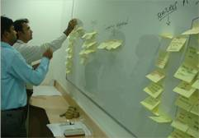
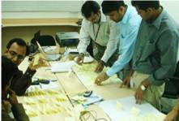
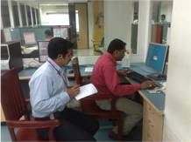
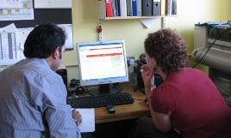
UXM->UX Research: Methods
UXM > UX Research : Methods
User Interviews
Stakeholder Interviews
SME Interviews (Subject Matter Expert)
Contextual Inquiry
Surveys
Demographic Research
Notes:
Page XX-15
<Course Name> <Lesson Name>
These are various UX Research practices conducted in Patni UX CoE,
User Interviews
Stakeholder Interviews
SME Interviews (Subject Matter Expert)
Contextual Inquiry
Surveys
Demographic Research
Additional notes for instructor

Slide 16

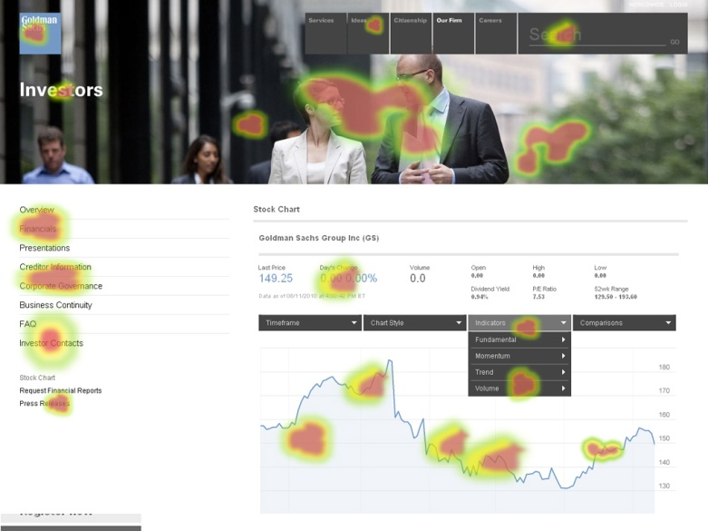
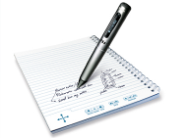
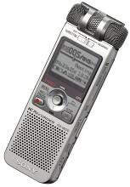
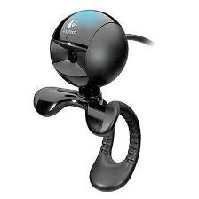
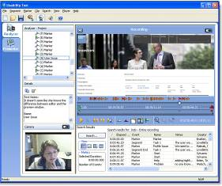
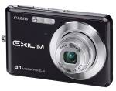
UXM->UX Research: ToolsUXM > UX Research : Tools
Eye Gaze Tracking System
Morae
Notes:
Page XX-16
<Course Name> <Lesson Name>
Eye Gaze Tracking System: To study users eye movement on the application.
Morae: To record the user study session both screen interaction as well as Audio and Video.
Devices
Web Cam
Audio Recorder
Recorder Pen
Digital Camera
Additional notes for instructor

Slide 17
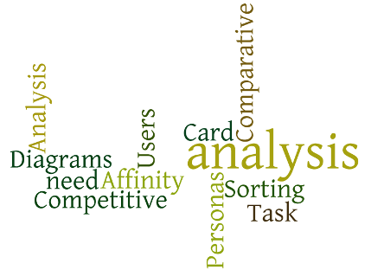
UXM->UX Analysis: What & WhyUXM > UX Analysis : What & Why
UX Research
UX Analysis
UX Design
UX Evaluation
Users need analysis
Task analysis
Comparative Competitive Analysis
Personas
Card Sorting
Affinity Diagrams
Notes:
Page XX-17
<Course Name> <Lesson Name>
UX Analysis is the next step after research has completed. Analysis covers any area that deals with understanding the problem and defining the desired outcomes. Analysis is about understanding the “why” and “what” of a project.
It is a crucial part of any design process. Without it, it’s impossible to know if the right problem is being solved and if it is being solved in the right way. It can also bring clarity to the detailed and often complex requirements that solutions must meet.
Additional notes for instructor

Slide 18
UXM->UX Analysis : What & WhyUXM UXM > UX Analysis : What & Why
UX Analysis
“Analysis covers any area that deals with understanding the problem and defining the desired outcomes. Analysis is about understanding the “why” and “what” of a project. ”
Why?
Create User need definition
Task Analysis
Notes:
Page XX-18
<Course Name> <Lesson Name>
Objective:
To understand the problem and define the desired outcomes. Analysis is about understanding the “why” and “what” of a project. ”
Process
Analysis of the findings from various research methods discussed in previous sections
Deliverables
Report with analysis about user needs and task analysis
Additional notes for instructor

Slide 19

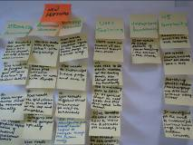
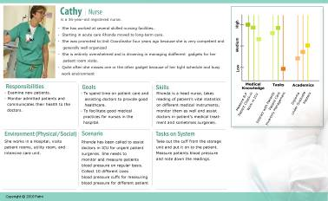

UXM->UX Analysis : MethodsUXM > UX Analysis : Methods
Users Need Analysis
Task Analysis
Use Cases
Comparative Competitive Analysis
Personas
Card Sorting
Affinity Diagrams
Notes:
Page XX-19
<Course Name> <Lesson Name>
These are various methods for UX Analysis
Users Need Analysis - This involves understanding the target audience, their typical tasks, and their specific constraints, usually through a combination of observational techniques, including interviews, surveys, artifact analysis, and consulting with domain experts. The results provide user interface objectives, system requirements, and feature requirements.
Task Analysis - Task analysis is a method that informs design by identifying and prioritizing the tasks that users will perform with a product, website, or service.
Use Cases
Comparative Competitive Analysis - Competitor analysis identifies the strengths and weaknesses of competing products or services before starting work on prototypes
Personas - It is a description of a specific person who is a target user of a system being designed, providing demographic information, needs, preferences, biographical information, and a photo or illustration. Typically, multiple personas are developed in the early stages of design.
Card Sorting - It is a technique for uncovering the hierarchical structure in a set of concepts by having users group items written on a set of cards, often used, for instance, to work out the organization of a website. For a website, users would be given cards with the names of the web pages on the site and asked to group the cards into related categories. After doing so, the users may be asked to break groups again into subgroups for large sites. After gathering the groupings from several users, designers can typically spot clear organizations across many users.
Affinity Diagrams - a simple technique for organizing concepts: designers write down ideas on a set of cards and then organize the cards by grouping them and by placing closely related concepts close to each other (e.g. by shuffling the cards on a table or pinning them to a wall); especially useful for uncovering the structure and relationships in a poorly understood domain. Affinity diagrams are often a good next step after a brainstorming sessions
Additional notes for instructor

Slide 20
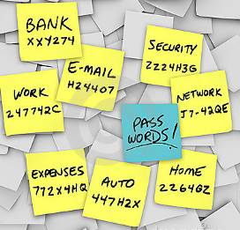
UXM->UX Analysis : ToolsUXM > UX Analysis : Tools
Parameter | Teamcenter | Windchill | Enovia
Cognitive Understanding | 1.00 | 2.00 | 1.00
Navigation & Menus | 1.00 | 1.00 | 3.00
Information Architecture | 3.00 | 1.00 | NA
Learnability | 3.00 | 2.00 | 4.00
Ease of Use | 2.00 | 2.00 | 4.00
Functional Features | 3.00 | 3.00 | 3.00
Help | 3.00 | 3.00 | 3.00
Aesthetics | 1.00 | 1.00 | 4.00
Performance / Operational Efficiency | 4.00 | 3.00 | 4.00
Average Rating | 46.00% | 40.00% | 65.00%
Notes:
Page XX-20
<Course Name> <Lesson Name>
These are the various tools for UX analysis such as Sticky notes, Photoshop and Microsoft office.
Additional notes for instructor

Slide 21
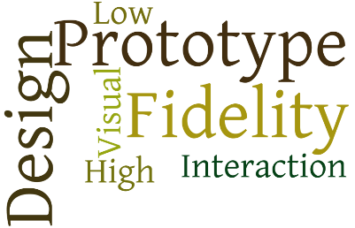
UXM->UX DesignUXM > UX Design
UX Research
UX Analysis
UX Design
UX Evaluation
Interaction Design
Visual Design
High Fidelity Prototype
Low Fidelity Prototype
Design Guidelines
Notes:
Page XX-21
<Course Name> <Lesson Name>
Interaction design
The design of how a user communicates, or interacts, with a computer. Interaction designers focus on the flow of interaction, the dialog between person and computer, how input relates to output, stimulus-response compatibility, and feedback mechanisms.
Additional notes for instructor

Slide 22
UXM->UX Design: What?X Design : What?
Interaction Design
“The design of how a user communicates, or interacts, with a computer. Interaction designers focus on the flow of interaction, the dialog between person and computer, how input relates to output, stimulus-response compatibility, and feedback mechanisms.”
Notes:
Page XX-22
<Course Name> <Lesson Name>
Add the notes here.
Additional notes for instructor

Slide 23
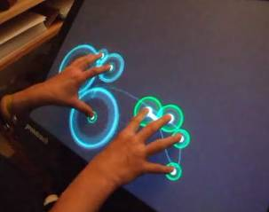

UXM->UX Design: Methods > UX Design : Methods
Interaction Design
Visual Design
High Fidelity Prototype
Low Fidelity Prototype
Notes:
Page XX-23
<Course Name> <Lesson Name>
These are the various methods for Interaction design
Interaction Design
Visual Design
High Fidelity Prototype
Low Fidelity Prototype
Additional notes for instructor

Slide 24
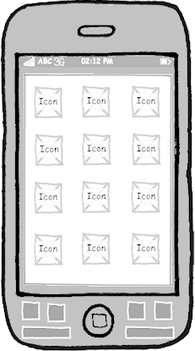
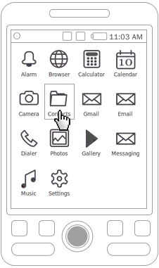
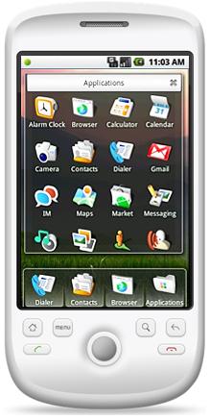
UXM->UX Design:Methods UXM > UX Design : Methods
Low Fidelity Prototype
High Fidelity Prototype
Visual Interface Design
Notes:
Page XX-24
<Course Name> <Lesson Name>
Prototyping is an essential element of an iterative design approach, where designs are created, evaluated, and refined until the desired performance or usability is achieved.
Prototypes can range from extremely simple sketches (low-fidelity prototypes) to full systems that contain nearly all the functionality of the final system (high-fidelity prototypes).
Additional notes for instructor

Slide 25



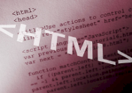







UXM->UX Design: ToolsUXM > UX Design : Tools
Notes:
Page XX-25
<Course Name> <Lesson Name>
These are the list of various UX design tools such as Photoshop, Dreamweaver, Illustrator, Visio, flash, HTML and CSS.
Additional notes for instructor

Slide 26
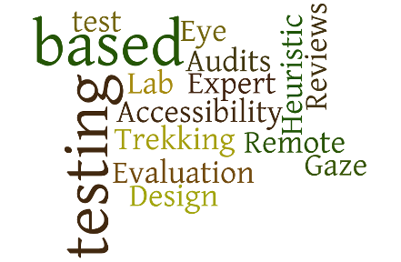
UXM->UX Evaluation
UX Research
UX Analysis
UX Design
UX Evaluation
Lab Testing
Remote Testing
Heuristic Evaluation
Design Audits
Expert Reviews
Eye Gaze Trekking
Accessibility Test
Notes:
Page XX-26
<Course Name> <Lesson Name>
Add the notes here.
Additional notes for instructor

Slide 27
UXM->UX Evaluation : What & Why
UXM > UX Evaluation : What & Why?
Definition
“Evaluation is integral to the design process. It collects information about users’ or potential users’ experiences when interacting with a prototype, computer system, a component of a computer system, or a design artifact, e.g. screen sketch, in order to improve its design. It focuses on both the usability of the system, e.g. how easy it is to learn and to use, and on the users’ experience when interacting with the system, e.g. how satisfying, enjoyable, or motivating the interaction is”
Why & When
To improve the design based on user or expert’s feedback
Notes:
Page XX-27
<Course Name> <Lesson Name>
UX Evaluation
Evaluation is integral to the design process. It collects information about users’ or potential users’ experiences when interacting with a prototype, computer system, a component of a computer system, or a design artifact, e.g. screen sketch, in order to improve its design. It focuses on both the usability of the system, e.g. how easy it is to learn and to use, and on the users’ experience when interacting with the system, e.g. how satisfying, enjoyable, or motivating the interaction is.
Additional notes for instructor

Slide 28

UXM->UX Evaluation : MethodsUXM > UX Evaluation : Methods
Lab based testing
Remote based testing
Heuristic Evaluation
Design Audits
Expert Reviews
Eye Gaze Trekking
Accessibility test
Notes:
Page XX-28
<Course Name> <Lesson Name>
These are the various methods for Evaluation.
Lab based testing
Remote based testing
Heuristic Evaluation
Design Audits
Expert Reviews
Eye Gaze Trekking
Accessibility test
Additional notes for instructor

Slide 29
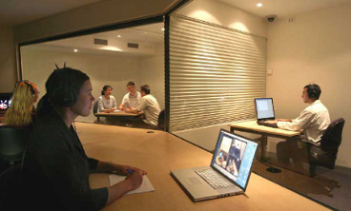
UXM->UX Evaluation : MethodsUXM UXM > UX Evaluation : Methods
How we conduct a Usability test
Develop a Usability Test Plan
Scope, Purpose, Schedule & Location, Recruiting Participants, Metrics, Roles
Preparation and Usability Testing
Creating task scenarios, Test setup, Conduct Usability Test, Create metrics
Data analysis and reports
Quantitative/Qualitative data, Reporting critical results, Findings and recommendations
Notes:
Page XX-29
<Course Name> <Lesson Name>
This describes a step by step process to conduct a Usability test,
Develop a Usability Test Plan
Scope, Purpose, Schedule & Location, Recruiting Participants, Metrics, Roles
Preparation and Usability Testing
Creating task scenarios, Test setup, Conduct Usability Test, Create metrics
Data analysis and reports
Quantitative/Qualitative data, Reporting critical results, Findings and recommendations
Additional notes for instructor

Slide 30

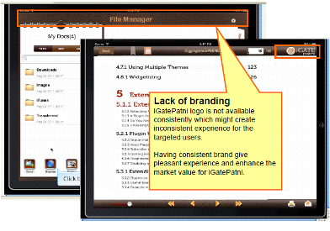

UXM->UX Evaluation : ToolsXM > UX Evaluation : Tools
Notes:
Page XX-30
<Course Name> <Lesson Name>
This is the list of various UX Evaluation tools used in UX team like Morae, UserVUE for Usability studies and Microsoft office to generate reports.
Additional notes for instructor

Slide 31
Web Accessibility
Web Accessibility
Web have a growing variety of characteristics. As web developers, we can not assume that all our users are accessing our content using the same web browser or operating system as we are, nor can we assume they’re using a traditional monitor for output, or keyboard and mouse for input.
Different user characteristic
Unable to see
Has dyslexia
Has low vision
Has a physical disability
Unable to hear
Using a mobile device
Limited bandwidth
Limited time
Notes:
Unable to see. Individuals who are blind use either audible output (products called screen readers that read web content using synthesized speech) or tactile output (a refreshable Braille device).
Has dyslexia. Individuals with learning disabilities such as dyslexia may also use audible output, along with software that highlights words or phrases as they’re read aloud using synthesized speech.
Has low vision. Individuals with low vision may use screen magnification software that allows them to zoom into all or a portion of the visual screen. Many others with less-than-perfect eyesight may enlarge the font on websites using standard browser functions, such as Ctrl + in Windows browsers or Command + in Mac browsers.
Has a physical disability. Individuals with physical disabilities that effect their use of hands may be unable to use a mouse, and instead may rely exclusively on keyboard or use assistive technologies such as speech recognition, head pointers, mouth sticks, or eye-gaze tracking systems.
Unable to hear. Individuals who are deaf or hard of hearing are unable to access audio content, so video needs to be captioned and audio needs be transcribed.
Using a mobile device. Individuals who are accessing the web using a compact mobile device such as a phone face accessibility barriers, just like individuals with disabilities do. They’re using a small screen and may need to zoom in or increase the font size, and they are likely to be using a touch interface rather than a mouse. Also, Apple’s iPhone and iPad do not support Adobe Flash.
Limited bandwidth. Individuals may be on slow Internet connections if they’re located in a rural area or lack the financial resources to access high-speed Internet. These users benefit from pages that load quickly (use graphics sparingly) and transcripts for video.
Limited time. Very busy individuals may have too little time to watch an entire video or audio recording, but can quickly access its content if a transcript is available.

Slide 32
Why Web Accessibility?
The Web is an increasingly important resource in many aspects of life: education, employment, government, commerce, health care, recreation, and more. It is essential that the Web be accessible in order to provide equal access and equal opportunity to people with disabilities. An accessible Web can also help people with disabilities more actively participate in society.
The Web offers the possibility of unprecedented access to information and interaction for many people with disabilities. That is, the accessibility barriers to print, audio, and visual media can be much more easily overcome through Web technologies.

Slide 33
Web Accessibility
Features of Accessible Websites
Good use of HTML headings
Accessible with keyboard
Accessible images
Accessible menus
Accessible forms
Accessible tables
Effective use of color
Meaningful link text
ARIA landmark roles
ARIA for web applications

Slide 34
Checking a Website for Accessibility
We can go a long way toward assuring your website is accessible by following these simple steps:
Validate your HTML.
Test with a keyboard.
Use an accessibility checker.
Test with users.
Ask for help.
Notes:
Validate your HTML. If HTML is used incorrectly, assistive technology can have problems interpreting the page content, which can result in access problems for users. Use an HTML validator to check your code.
Test with a keyboard. Set your mouse aside and use the tab key to navigate through your web pages. You should be able to access all interactive features (e.g., menus, links, form fields, buttons, controls) and operate them by pressing Enter, space, arrow keys or other intuitive keystrokes. If you are unable to access some of your site’s features, your site is likely to have accessibility problems.
Use an accessibility checker. There are several free online tools that will check your web pages for accessibility. See our Tools and Resources page for an annotated list. Also, the UW has an enterprise license for Siteimprove, a powerful tool that scans your site at regular intervals for broken links, spelling errors, and accessibility problems. More information on Siteimprove will be added to this site soon.
Test with users. The UW’s Laboratory for Usability Testing and Evaluation (LUTE) provides a controlled setting for conducting usability tests, and is available by reservation to the UW community. You could also test your site less formally by simply recruiting and observe users as they interact with your site. To test for accessibility, recruit users who have a variety of skill levels and characteristics, such as those listed below under the heading What Is Accessibility?
Ask for help. The UW community is actively working toward the goal of full accessibility for all visitors to its websites. Since we’re all working together toward this goal, there are many in the community who are happy to help.

Slide 35
Web Accessibility-section 508
The legislation referred to as "Section 508" is actually an amendment to the Workforce Rehabilitation Act of 1973. The amendment was signed into law by President Clinton on August 7, 1998. Section 508 requires that electronic and information technology that is developed by or purchased by the Federal Agencies be accessible by people with disabilities.
Pass Fail
508 STANDARD
Equivalent alternatives for any multimedia presentation shall be synchronized with the presentation. | Content presented through video, but not through audio is provided in an audio description track. | Video files or live audio broadcasts do not have captions or captions are not synchronized.
 | Video files and live audio broadcasts have synchronized captions | Audio descriptions are not provided for visual-only content in multimedia.

Slide 36
508 Standard | Pass | Fail
Web pages shall be designed so that all information conveyed with color is also available without color, for example from context or markup. | Color is not used solely to convey important information. Sufficient contrast is provided. | Color is the sole means of conveying information. Contrast is poor.
Documents shall be organized so they are readable without requiring an associated style sheet. | Style sheets may be used for layout, but the document is still readable and understandable | The document is confusing or information is missing when the style sheet is turned off.
Redundant text links shall be provided for each active region of a server-side image map. | Client-side image maps are used instead of server-side image maps. Appropriate alternative text is provided for the image as well as each hot spot area. | Server side image maps or inaccessible client-side image maps are present.
Notes:
Refer http://webaim.org/standards/508/checklist for more about 508

Slide 37
Review Question
What is most important when developing easy-to-use products?
Understanding the users and their tasks
Following the style guide
Making interfaces as consistent as possible
Using object-oriented development tools
Using a hammer
Which of the following is most important in user-centred design?
An object-oriented development process
Iterative design and user testing
Regular design demonstrations
Including every function each user wants
Shouting at the user
When during product development is it best to start obtaining user input?
Requirements definition
Prototyping
Implementation
Testing
Never
Notes:
Add the notes here.
Answers for the Review Questions:

